Slide 1
Volcanic Vocalic Changes
UGA Linguistics Colloquium
April 7, 2017
Joey Stanley

Slide 2
Cowlitz County, Washington
O
O
V
O
0
0
O
0
Notes:
Mt. St. Helens: 36 miles as the crow flies
Loggers, mill workers
Why Longview?
History of the town, mills.
Census data (northerners at first, southerners later on)

Slide 3
The West
“low homogeneity” and “low consistency”
(Labov, Ash, Boberg 2006:277)
cot-caught merger
fronting of /u/
lack of Southern, Midland, and Canadian features

Slide 4
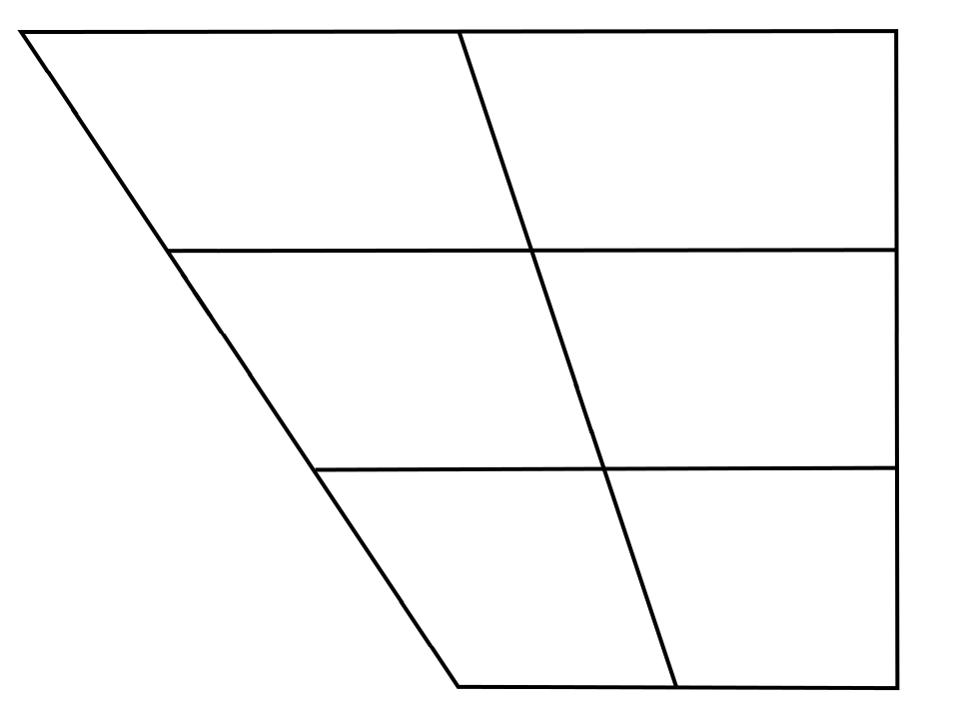
Pacific Northwest English
(vague, plague, flagrant)
eg
o
low, sew, row, throw, mow, show, go, toe, know, doe
(peg, legacy, integrity, segment)
ɛg
(dragon, snag, agony, brag, wagon, jaguar)
æg
(Ward 2003, Becker et al. 2013,
McLarty & Kendall 2014,
Becker et al. 2016, etc.)
(Wassink et al. 2009, Freeman 2014,
Riebold 2015, Wassink 2015, Wassink 2016, etc.)

Slide 5
Hypotheses
pre-velars
Hypothesis 1: Longview is like the rest of Washington
back vowels
Hypothesis 2: /o/ is fronted
Hypothesis 3: /o/ is monophthongized
Volcano
Hypothesis 4: These three changes have to do with a volcano

Slide 6
Methodology

Slide 7
Data Collection
41 natives of Cowlitz County, ages 18–70s
29-item word list (see appendix slides)
forced aligned with DARLA (Reddy & Stanford 2015), which uses ProsodyLab (Gorman et al. 2011) and FAVE (Rosenfelder et al. 2014)
used a Praat script to extract vowel formants at the midpoint
Bark normalized measurements (Traunmüller 1997)
Lobanov transformation not used because I’m not working with the full vowel space (Thomas & Kendall 2015)
Number of tokens
pre-velars | 549
/o/ | 348
total | 897
Notes:
Add animations here. One line at a time.

Slide 8
Analysis
Mixed-effects models (Baayen 2008)
lmer() in the R package lme4 (Bates et al. 2015)
Effects are reported significant if p < 0.01.
Appendix slides:
more detailed explanation of statistical methods
all model outputs
interpretation of each model

Slide 9
Results 1: Pre-Velars

Slide 10
Pre-Velars: Distribution
vague and beg merged somewhere in the middle of /ek/ and /ɛk/.
merger by approxi-mation (Labov 1994)
bag is raised to the /ɛk/ space
Notes:
BAKE
DECK
BACK
(Merger by Approximation) (Also, transfer and expansion)
VAGUE
BEG
BAG

Slide 11
Age + Generation
high overlap between vague and beg for all groups
older men raise bag almost to merge with vague/beg
younger group (in this sample) does not raise bag
Notes:
Tell about the worker at LCC that said DRAGON, FLAG.

Slide 12
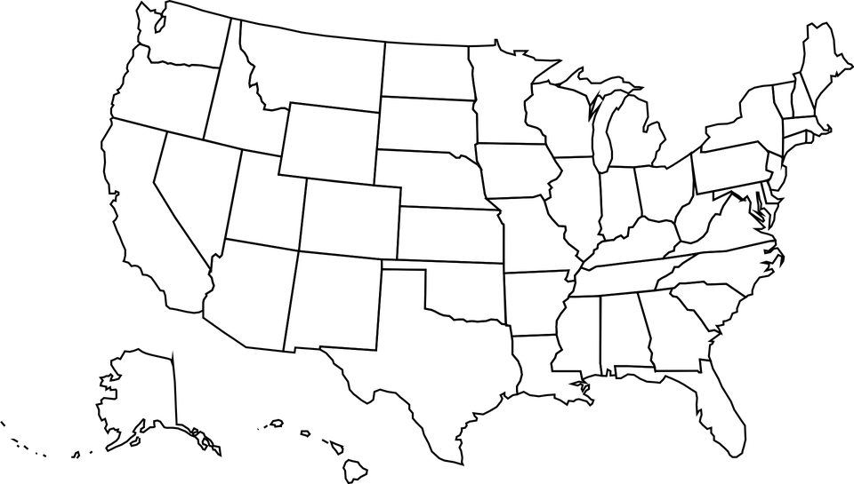
Pre-Velars in other Regions
Notes:
But I do raise in NEGLIGENT

Slide 13
Pre-Velars in other Regions
Seattle, Spokane, Yakima (Wassink 2016)
beg and bag raised by all speakers (male/female, young/old)
Me
beg raising, except exit, exile, segregate, and integrity
British Columbia (Cardoso 2016)
beg and bag raising
Cowlitz County, WA
beg raising in everyone
bag raising in older speakers
Montana (anecdotally)
bag raising
Wisconsin (Bauer and Parker 2008)
bag raising
Michigan (Roeder 2009)
bag raising
Portland and E. Oregon (McLarty et al. 2016; Becker et al. 2016)
beg and bag raising mostly in older speakers
San Francisco (Cardoso et al. 2016)
Some beg and bag raising
Nevada (Fridland et al. 2015)
beg raising
Notes:
But I do raise in NEGLIGENT

Slide 14
Regression Model
(see model 1 in the appendix)
Best generation split was around 1970 (46 years old)
why this is important, later…

Slide 15
Results 2: /o/ Fronting

Slide 16
All Back Vowels

Slide 17
/o/ Fronting
/o/ is gradually fronting over time (see model 2 in the appendix)
marginally significant break-point at 1970 (Baayan 2008 §6.4)
/u/ and /ʊ/ are also fronting too at slightly different rates (output omitted)

Slide 18
/o/ Fronting in other Regions
Washington (Wassink 2015, 2016)
/o/ not fronted
North (Labov et al. 2006)
/o/ is furthest back
Cowlitz County, WA
fronted in younger speakers
Portland (Becker et al. 2016)
everyone fronts /o/
Portland (Ward 2003)
younger, working class women most fronted
California (citation)
fronting as part of the CVS
South (Labov et al. 2006)
most advanced /o/ fronting
Notes:
Settlement history is why older people don’t front /o/? Influx of southerners in the 70s and 80s brought /o/ fronting?

Slide 19
Results 3: /o/ Monophthongization

Slide 20
Trajectories
distance from 20% to 80%
messy data still, but the numbers match my intuition

Slide 21
Monophthongization of /o/ over time
older generation = more monophthongal (see model 3 in the appendix)
jump at 1970
men generally more monophthongized

Slide 22
Discussion

Slide 23
Generational Divide
 | Older (born before 1970) | Younger (born after 1970)
bag | raised | lowered
back vowels | back | fronted
/o/ | monophthongized | diphthongized

Slide 24
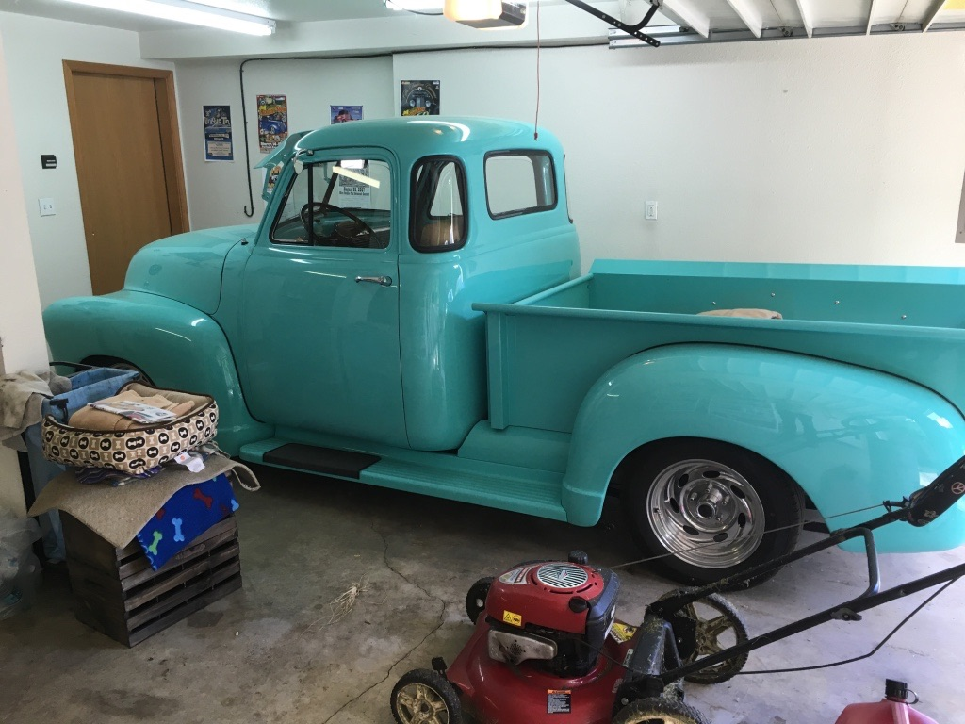
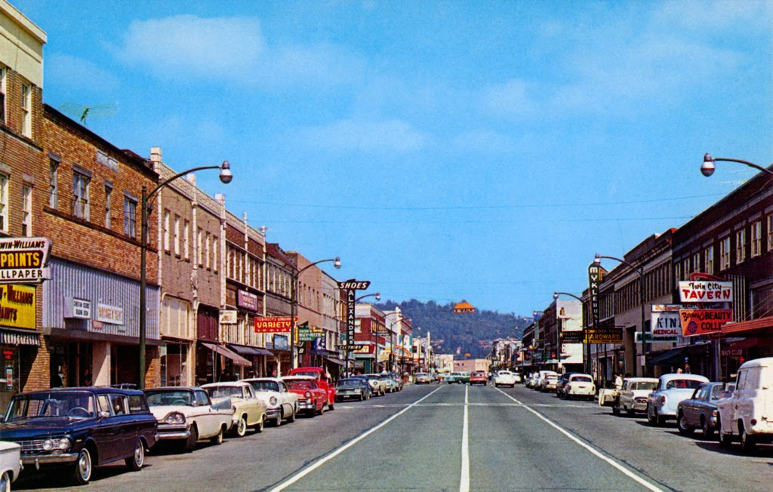
So what happened in 1970?
Carol
Ed
1923
1970
1980
1985
2016
nothing

Slide 25
Conclusion

Slide 26
Conclusion
✓ Hypothesis 1: Longview is like the rest of Washington
Mostly true, except bag raising only for older people
✓ Hypothesis 2: back vowels are being fronted
Yes, but only by the younger speakers
✓ Hypothesis 3: some /o/ monophthongization
Yes, mostly by older speakers
? Hypothesis 4: Mount St. Helens might be an influencing factor.

Slide 27
References
Baayen, R. H. 2008. Analyzing Linguistic Data: A Practical Introduction to Statistics using R. Cambridge: Cambridge University Press.
Bates, Douglas, Martin Maechler, Ben Bolker & Steve Walker. 2015. Fitting Linear Mixed-Effects Models Using lme4. Journal of Statistical Software 67(1). 1–48. doi:doi:10.18637/jss.v067.i01.
Bauer, Matt & Frank Parker. 2008. /æ/-raising in Wisconsin English. American Speech 83(4). 403–431.
Becker, Kara, Anna Aden, Katelyn Best, Rena Dimes, Juan Flores & Haley Jacobson. 2013. Keep Portland weird: Vowels in Oregon English. Paper presented at the New Ways of Analyzing Variation (NWAV) 42, Pittsburgh.
Becker, Kara, Anna Aden, Katelyn Best & Haley Jacobson. 2016. Variation in West Coast English: The case of Oregon. In Valerie Fridland, Betsy E. Evans, Tyler Kendall & Alicia Beckford Wassink (eds.), Speech in the Western States, Vol. 1: The Pacific Coast, 107–134. (Publication of the American Dialect Society 101). Durham, NC: Duke University Press. doi: 10.1215/00031283-3772923.
Cardoso, Amanda. Pre-velar Raising in Western Canadian Dialects. Unpublished manuscript. Cited in Cardoso et al. (2016).
Cardoso, Amanda, Lauren Hall-Lew, Yova Kementchedjhieva & Ruaridh Purse. 2016. Between California and the Pacific Northwest: The front lax vowels in San Francisco English. In Betsy Evans, Valerie Fridland, Tyler Kendall & Alicia Wassink (eds.), Speech in the Western States: Volume 1: The Coastal States, 33–54. (Publication of the American Dialect Society 101). Durham, NC: Duke University Press. doi: 10.1215/00031283-3772890.
Freeman, Valerie. 2014. Bag, beg, bagel: Prevelar raising and merger in Pacific Northwest English. University of Washington Working Papers in Linguistics 32.
Fridland, Valerie, Tyler Kendall & Craig Fickle. 2015. It’s Neva-ae-da, not nev-ah-da. Paper. Paper presented at the Annual Meeting of the American Dialect Society, Portland, Oregon.
Labov, William. 1994. Principles of linguistic change. Vol. 1: Internal features. Oxford: Blackwell.
Labov, William, Sharon Ash & Charles Boberg. 2006. The Atlas of North American English: Phonetics, Phonology and Sound Change. Walter de Gruyter.
McLarty, Jason & Tyler Kendall. 2014. The relationship between the high and mid back vowels in Oregonian English. Paper presented at the New Ways of Analyzing Variation (NWAV) 43, Chicago.
Gorman, Kyle, Jonathan Howell & Michael Wagner. 2011. Prosodylab-Aligner: A Tool for Forced Alignment of Laboratory Speech. Canadian Acoustics 39(3). 192–193.
Levshina, Natalia. 2015. How to do Linguistics with R: Data exploration and statistical analysis. Amsterdam: John Benjamins Publishing Company.
McLarty, Jason, Tyler Kendall & Charlie Farrington. 2016. Investigating the development of the contemporary Oregonian English vowel system. In Valerie Fridland, Betsy E. Evans, Tyler Kendall & Alicia Beckford Wassink (eds.), Speech in the Western States, Vol. 1: The Pacific Coast, 135–157. (Publication of the American Dialect Society 101). Durham, NC: The American Dialect Society. doi: 10.1215/00031283-3772934.
Reddy, Sravana & James N. Stanford. 2015. Toward completely automated vowel extraction: Introducing DARLA. Linguistics Vanguard. doi:10.1515/lingvan-2015-0002 (26 October, 2015).
Riebold, John Matthew. 2015. The Social distribution of a regional change: /æg, ɛg, eg/ in Washington State. Seattle: University of Washington PhD dissertation.
Roeder, Rebecca. 2009. The effects of phonetic environment on English /ae/among speakers of Mexican heritage in Michigan. Toronto Working Papers in Linguistics 31. http://twpl.library.utoronto.ca/index.php/twpl/article/view/6090 (6 April, 2017).
Rosenfelder, Ingrid, Josef Fruehwald, Keelan Evanini, Scott Seyfarth, Kyle Gorman, Hilary Prichard & Jiahong Yuan. 2014. FAVE (Forced Alignment and Vowel Extraction) Program Suite v1.2.2.
Thomas, Erik, and Tyler Kendall. "NORM: Vowel Normalization Suite 1.1 | Methods." N.p., 18 Nov. 2015. Web. Accessed 12 January, 2017.
Traunmüller, Hartmut. 1997. Auditory scales of frequency representation. Stockholms universitet: Instituionen för lingvistik. http://www2.ling.su.se/staff/hartmut/bark.htm (17 November, 2016).
Ward, Michael. 2003. Portland dialect study: The fronting of/ ow, u, uw/ in Portland, Oregon. Portland State University Master’s Thesis. http://www.pds.pdx.edu/Publications/Ward.pdf (15 February, 2016).
Wassink, Alicia Beckford. 2015. Sociolinguistic Patterns in Seattle English. Language Variation and Change 27(1). 31–58. doi:10.1017/S0954394514000234.
Wassink, Alicia Beckford. 2016. The Vowels of Washington State. In Betsy Evans, Valerie Fridland, Tyler Kendall & Alicia Wassink (eds.), Speech in the Western States: Volume 1: The Coastal States, 77–105. (Publication of the American Dialect Society 101). Durham, NC: Duke University Press. 10.1215/00031283-3772912.
Wassink, Alicia Beckford, Robert Squizzero, Mike Scanlon, Rachel Schirra & Jeff Conn. 2009. Effects of Style and Gender on Fronting and Raising of /æ/, /e:/ and /ε/ before /ɡ/ in Seattle English. Paper presented at the New Ways of Analyzing Variation (NWAV) 38, Ottawa.

Slide 28
Joey Stanley
University of Georgia
joeystan@uga.edu @joey_stan
joeystanley.com
Special thanks to Cathy Jones for invaluable help in finding research participants,
to the University of Georgia Graduate School Dean’s Award for funding the fieldwork.
These slides available at
joeystanley.com/colloquium

Slide 29
Appendix A: Word List and Minimal Pairs

Slide 30
Word List Items
These were embedded psuedorandomly in a 160-item word list, with words targeting other research questions acting as fillers.
Participants often commented on how random the words seemed, so they likely did not catch on to the research questions these words targeted.
Words in parintheses were used as pre-voiceless reference points.
/eg/ | flagrant, plague, vague (bacon)
/ɛg/ | exit, integrity, legacy, peg, regular, segment (deck)
/æg/ | agony, brag, dragon, jaguar, rag, snag, wagon (black)
/o/ | bow, doe, go, know, low, mow, row, sew, show, toe

Slide 31
Appendix B: Statistical Tests

Slide 32
Analysis
I use generalized linear mixed-effects models (Baayen 2008) using the function glmer() in the R package lme4 (Bates et al. 2015), with speaker and word as random effects and sex and some form of age/generation as a fixed effect.
The older generation was defined as those born on or before 1970.
Effects are reported significant if p<0.01.
For each hypothesis, three models were tested to see how age should be coded that included either 1) age as a continuous factor, 2) generation as a binary variable, or 3) only the interaction of age and generation to test the breakpoint.
All three models fit using maximum liklihood (ML) and were compared to a model without age at all (a null model) using the anova() function. The model with the lowest BIC was chosen and refit using restricted maximum liklihood (REML). The output of these final models is given in the following slides.
See Baayan (2008) for regression with breakpoints, and Levshina (2015) for model comparison.

Slide 33
(1) Linear mixed-effects model fit by REML of bark-normalized height (bark(F3)–bark(F1)) of pre-velar vowels with sex (F*, M) and generation (older, younger) as fixed effects and speaker and word as random effects.
(2) Linear mixed-effects model fit by REML of bark-normalized backness (bark(F3)–bark(F2)) of /o/ with sex (F*, M) and age (as a continuous variable) as fixed effects and speaker and word as random effects.
Random effects
 | Variance | Std. Dev.
word | 0.484 | 0.696
speaker | 0.048 | 0.219
residual | 0.598 | 0.773
Random effects
 | Variance | Std. Dev.
word | 0.274 | 0.523
speaker | 0.038 | 0.195
residual | 0.662 | 0.813
Fixed effects
 | Value | Std.Error | t-value
(Intercept) | 7.886 | 0.212 | 37.16
sex: M | 0.599 | 0.281 | 2.13
generation: younger | –1.455 | 0.278 | –5.24
Interpretation: The younger generation produced a lower bag vowel than the older generation. The effect of sex was only marginally significant based on the small t-value (<3).
Fixed effects
 | Value | Std.Error | t-value
(Intercept) | 4.312 | 0.337 | 12.78
sex: M | 0.326 | 0.215 | 1.52
generation: younger | –0.034 | 0.007 | –5.11
Interpretation: The model technically shows that the older someone was the backer their /o/ vowel would be. To put it another way, /o/ is fronting in apparent time. The effect of sex was not significant based on the small t-value (<2).
* Underlined values are the reference levels

Slide 34
(3) Linear mixed-effects model fit by REML of trajectories of /o/ with sex (F*, M) and generation (older, younger) as fixed effects and speaker and word as random effects.
Random effects
 | Variance | Std. Dev.
word | 4767 | 69.04
speaker | 9274 | 96.30
residual | 10082 | 100.41
Fixed effects
 | Value | Std.Error | t-value
(Intercept) | 387.92 | 34.72 | 11.17
sex: M | –110.88 | 27.95 | –3.967
generation: younger | 96.59 | 27.56 | 3.504
Interpretation: The younger generation had longer trajectories than the older generation. Men had shorter trajectories than women.
* Underlined values are the reference levels

